Slide 1
Course : Scientific English II
CHAPTER I . Scientific journals
Departement : Material Sciences
Speciality : L3 Chemistry and Physics
Realized by :
Dr. FIZIR .M

Slide 2
What are scientific journals?
Scientific journal
In academic publishing, a scientific journal is a periodical publication intended to further the progress of science, usually by reporting new research.
Articles in scientific journals are mostly written by active scientists such as students, researchers and professors instead of professional journalists.

Slide 3
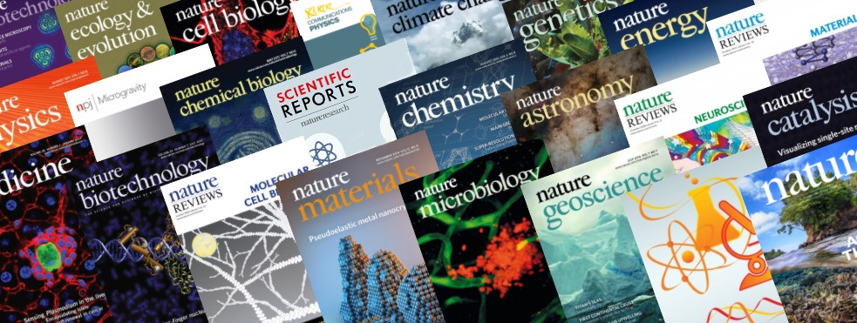
There are thousands of scientific journals in publication. Most journals are highly specialized, although some of the oldest journals such as Nature publish articles and scientific papers across a wide range of scientific fields.

Slide 4
Scientific journals contain articles that have been peer reviewed, in an attempt to ensure that articles meet the journal's standards of quality, and scientific validity.
Although scientific journals are superficially similar to professional magazines, they are actually quite different. Issues of a scientific journal are rarely read casually, as one would read a magazine. The publication of the results of research is an essential part of the scientific method. If they are describing experiments or calculations, they must supply enough details that an independent researcher could repeat the experiment or calculation to verify the results.
Each such journal article becomes part of the permanent scientific record.

Slide 5
Scientific journals used for what ?
Articles in scientific journals can be used in research and higher education.
Scientific articles allow researchers to keep up to date with the developments of their field and direct their own research.
An essential part of a scientific article is citation of earlier work.
The impact of articles and journals is often assessed by counting citations (citation impact)
Articles tend to be highly technical, representing the latest theoretical research and experimental results in the field of science covered by the journal.
They are often incomprehensible to anyone except for researchers in the field and advanced students

Slide 6
List of scientific journals
The following is a partial list of scientific journals. There are thousands of scientific journals in publication.
The list given here is far from exhaustive, only containing some of the most influential, currently publishing journals in each field. As a rule of thumb, each field should be represented by more or less than ten positions, chosen by their impact factors and other ratings.
General and multidisciplinary science

Slide 7
Materials science
ACS Nano
Advanced Functional Materials
Advanced Materials
Annual Review of Condensed Matter Physics
Journal of Materials Chemistry A (energy and sustainability)
Journal of Materials Chemistry B (biology and medicine)
Journal of Materials Chemistry C (optical, magnetic and electronic devices)
Nano Letters
Nature Materials
Nature Nanotechnology
Progress in Materials Science
Progress in Polymer Science
Materials Horizons

Slide 8
what kinds of articles do scientific journals publish?
It is helpful to familiarise yourself with the different types of articles published by journals. Most articles published are one of the following types:
Original Research,
Review Articles,
Short reports or Letters,
Case Studies.

Slide 9
Original Research:
This is the most common type of journal manuscript used to publish full reports of data from research. It may be called an Original Article, Research Article, Research, or just Article, depending on the journal. The Original Research format is suitable for many different fields and different types of studies.
It includes full Introduction, Methods, Results, and Discussion sections.

Slide 10
Short reports or Letters:
Short Communications are short papers that present original and significant material for rapid dissemination. For example, a Short Communication may focus on a particular aspect of a problem or a new finding that is expected to have a significant impact. Short articles include, but are not limited to: discovery or development of new materials, cutting-edge experiments and theory, novelty in simulation and modeling, elucidation of mechanisms. As Short Communications are expected to have higher than average impact on the field rather than report on incremental research, they will receive prioritized and rapid publication.
Short Communications are usually limited to 3000 words. The paper should contain an abstract, main body and references, and contain no more than 6 figures or tables, combined. The abstract is limited to 100 words. so some experimental details may not be published until the authors write a full Original Research manuscript

Slide 11
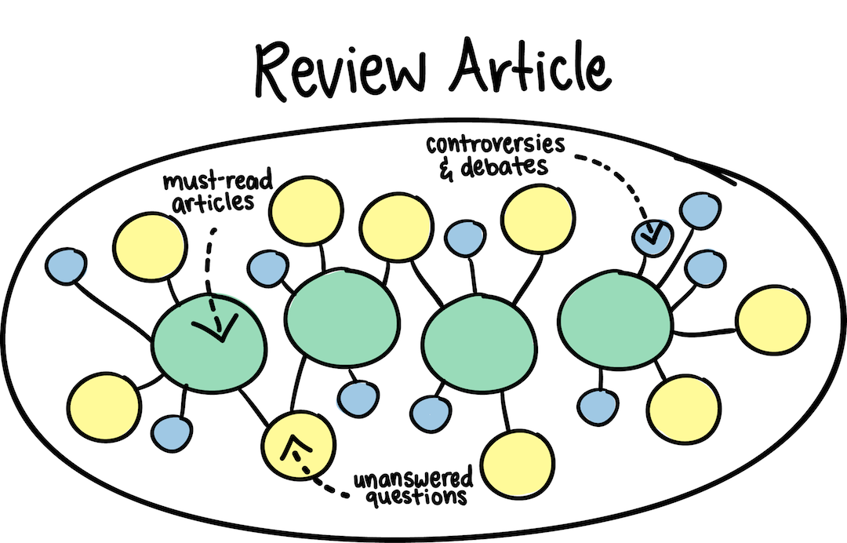
Review Articles:
Review Articles provide a comprehensive summary of research on a certain topic, and a perspective on the state of the field and where it is heading. They are often written by leaders in a particular discipline after invitation from the editors of a journal.
Reviews are often widely read (for example, by researchers looking for a full introduction to a field) and highly cited. Reviews commonly cite approximately 100 primary research articles. TIP: If you would like to write a Review but have not been invited by a journal, be sure to check the journal website as some journals to not consider unsolicited Reviews. If the website does not mention whether Reviews are commissioned it is wise to send a pre-submission enquiry letter to the journal editor to propose your Review manuscript before you spend time writing it.

Slide 12
Case Studies:
These articles report specific instances of interesting phenomena. A goal of Case Studies is to make other researchers aware of the possibility that a specific phenomenon might occur. This type of study is often used in medicine to report the occurrence of previously unknown or emerging pathologies.

Slide 13
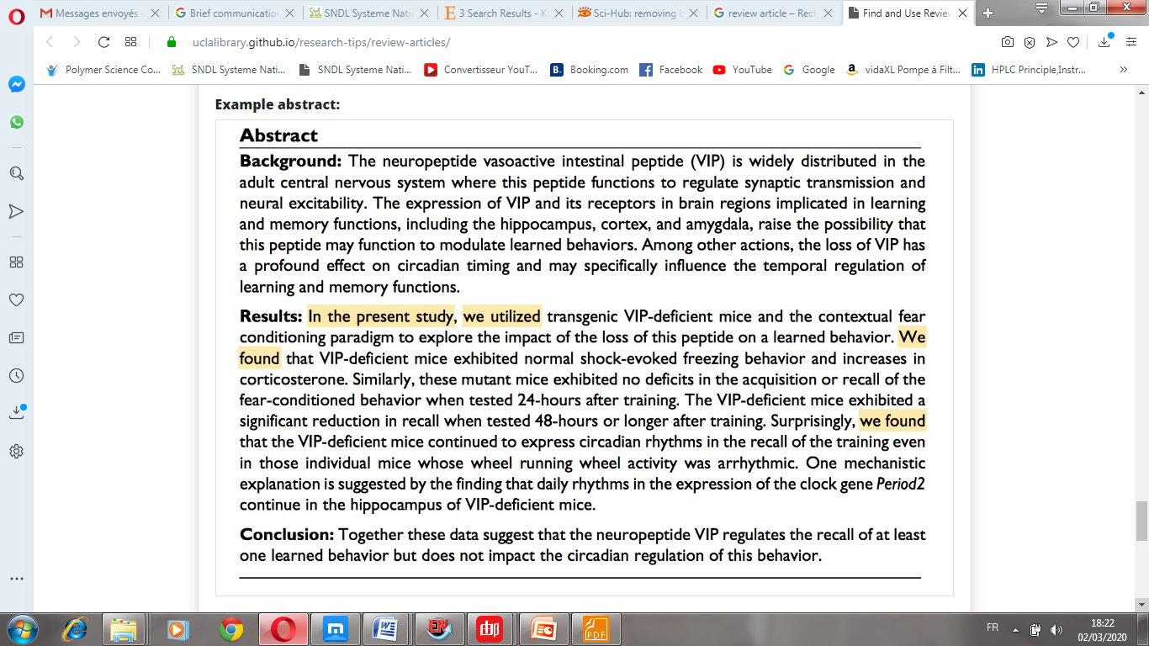
How do I know if an article is a Review Article or a Primary Research Article?

Slide 14
How do I know if an article is a Review Article or a Primary Research Article?

Slide 15
How is a manuscript evaluated for publication in a scientific journal?
1. A manuscript is first submitted to a journal by the author(s) for potential publication. 2. Authors carefully select a journal based upon the content of their article and the intended audience.
3. The editor determines whether the manuscript is within the editorial domain of the journal and appears to be an appropriate submission.
On average, over 97% of submissions to journals published by the American Psychological Association, for example, are referred to outside experts for peer review of their merits.

Slide 16
What is peer review?
Peer review is a process whereby two or more experts in the relevant topic area evaluate manuscripts for potential publication at the request of the journal editor.
Reviewers are carefully selected based on their scientific expertise, research area, and lack of bias toward the authors of a given manuscript. (Manuscripts are often circulated for peer review without their title pages to mask the identity of the authors and eliminate reviewer bias.)
The reviewers, who usually remain anonymous, submit their written critiques to the journal editor, including attention to the strengths and weaknesses of the manuscript, together with editorial suggestions and recommendations.

Slide 17
The editor reads the manuscript and the reviewers’ comments to make a determination as to whether the manuscript should be rejected, revised and resubmitted for further review, or accepted.
Reviewers are not financially compensated for their work; they often spend between four and 12 hours (depending on the length and complexity of the manuscript) in completing a thoughtful, extensive editorial review, as one of their service contributions to the advancement of science. Journal editors may receive a small stipend.

Slide 18
Home work : What is Scopus? What is SCI journals ? What is the difference between scopus and thomson routers ? How they calculate the impact factor of journals ?

