Slide 1
University of Khemis Miliana Faculty of Law & Political Science Department of Political Science POLITICAL ENGLISH BY MESTEK YAHIA MOHAMED LAMINE
m.mestek-yahia@univ-dbkm.dz
@laminemestek
lamine.mestek
Lamine.mestek

Slide 2
My Youtube Channel

Slide 3
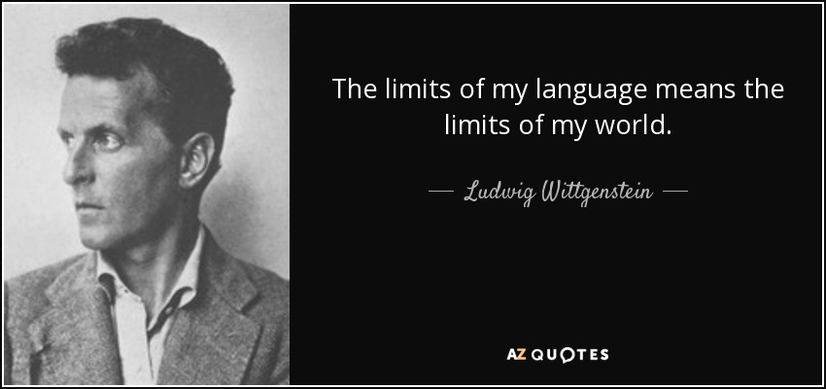
Today Quote

Slide 4
Introduction
This course is for students who are learning English and who are interested in finding out more about Political Vocabulary and improving their English language skills.
Of all topics relating to English Vocabulary, Politics is, without doubt, the most difficult! The words used are so specific they cannot be changed without sounding ‘odd’ to a native Briton.
We will try to tread through this minefield together to understand the keywords and phrases.

Slide 5
Class Rules
There is no rules except one
1- Speak only in English.

Slide 6
Key Questions
what does this word mean?.
Could you explain more?... Please.
Could you give an example on this? ..Please.
Could you repeat ? …Please.
How can I say….. In English?

Slide 7
English Accent

Slide 8
Content
General Political Vocabulary
War & Military Vocabulary
UN & Conflict resolution (Peace)
Political Economie Vocabulary
How to write an essay
Public Speaking training

Slide 9
Objectives and outcomes
After completing this course, you will be able to:
Read & Understand political text.
Deliver a speech with an appropriate style.
Write an essay & describe different types of graphs

Slide 10
Our Magazine

Slide 11
General Political Vocabulary
Political people
1) This person is the head of the government.
2) This person is the head of state.
3) These people are elected to represent their areas (Wilayas). They are also known as MPs.
4) This is the name of the main right-wing party.
5) This is the name of the main left-wing party.
Notes:
- Politics (from Greek: πολιτικός politikos, definition "of, for, or relating to citizens") is the process of making decisions applying to all members of each group.
A political party is defined as an organised group of people with at least roughly similar political aims and opinions, that seeks to influence public policy by getting its candidates elected to public office
An election is a formal decision-making process by which a population chooses an individual to hold public office
A referendum is a direct vote in which an entire electorate is asked to vote on a particular proposal. This may result in the adoption of a new law.
- Democracy is further defined as (a:) "government by the people; especially : rule of the majority. "a government in which the supreme power is vested in the people and exercised by them directly or indirectly through a system of representation

Slide 12
General Political Vocabulary
Politics
Party
Election
Vote
Democracy
State
Referendum
Notes:
- Politics (from Greek: πολιτικός politikos, definition "of, for, or relating to citizens") is the process of making decisions applying to all members of each group.
A political party is defined as an organised group of people with at least roughly similar political aims and opinions, that seeks to influence public policy by getting its candidates elected to public office
An election is a formal decision-making process by which a population chooses an individual to hold public office
A referendum is a direct vote in which an entire electorate is asked to vote on a particular proposal. This may result in the adoption of a new law.
- Democracy is further defined as (a:) "government by the people; especially : rule of the majority. "a government in which the supreme power is vested in the people and exercised by them directly or indirectly through a system of representation

Slide 13
General Political Vocabulary
sentence completion
Complete the following sentences to express your own opinion.
1) In my opinion, most politicians…
2) If I were Prime Minister or President of my country I would…
3) The political system in my country is…
4) I wish politicians would…
5) In an ideal world…
Notes:
- Politics (from Greek: πολιτικός politikos, definition "of, for, or relating to citizens") is the process of making decisions applying to all members of each group.
A political party is defined as an organised group of people with at least roughly similar political aims and opinions, that seeks to influence public policy by getting its candidates elected to public office
An election is a formal decision-making process by which a population chooses an individual to hold public office
A referendum is a direct vote in which an entire electorate is asked to vote on a particular proposal. This may result in the adoption of a new law.
- Democracy is further defined as (a:) "government by the people; especially : rule of the majority. "a government in which the supreme power is vested in the people and exercised by them directly or indirectly through a system of representation

Slide 14
General Political Vocabulary
Vote for us!
You are going to create a new political party! Think of a name for your party and think of five things you will do if you are elected. Then try to persuade your classmates to vote for you.
The _________________ Party
If we are elected we will:
1-
2-
3-
4-
5-

Slide 15
War & Military Vocabulary
Military
War
Weapons
Or
Arms
Ally / Coalition
Ceasefire
Guerilla
Militia
Branch
&
Rank
Notes:
WAR a state of armed conflict between different countries or different groups within a country.
Algerian Branch Army: 1-Land Force, 2- Air Force, 3-Naval Force 4-Air teritory defence forces 5- National Gendarmerie 6-Republican Guard 7-People’s National Army Staff (Etat Major de l’ANP)
Rank: Officers: General/ Admiral/ Colonel/ Major/ Captain / lieutenant
Enlisted: Sergent corporal
POW: Prisoner of War
KIA: Killed in Action
MIA: Missing in Action

Slide 16
UN & Conflict resolution (Peace)
United Nations
(UN)
Diplomacy
Human Rights
Peace Building
General Assembly
Security council
(UNSC)
Peace Keeping

Slide 17
United Nation

Slide 20
Security council (UNSC)

Slide 22
Public Speaking: Tips & Techniques

Slide 23
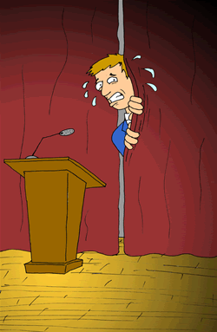
Public Speaking: Tips & Techniques
“According to most studies, people's number one fear is public speaking. Number two is death. Death is number two. Does that sound right?

Slide 24
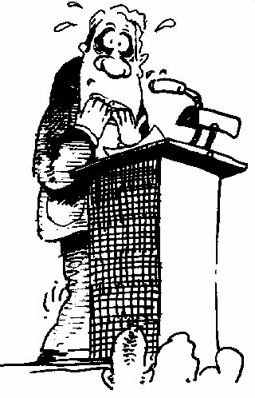
Why Do We Hate Public Speaking?
Lack of Positive Experience
Being the Center of Attention
Feelings of Isolation
Being Judged by an Audience
Fear of Failure
All of which are part of:
Public Speaking Anxiety

Slide 25
Body Language
Content
Visual Contact
What really matters?
AudioVisual Support
Tone
Stage Fright Control

Slide 26
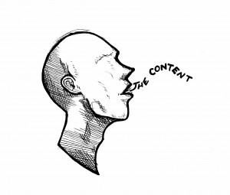
How Can I Become a Better Speaker?
Prepare the right way. Start by answering these questions:
What is the specific purpose of your speech?
What is your topic?
Who is your audience?
What are your time constraints?
Will you be using visual aids?

Slide 27
Pre-Performance Tips
Common qualities in speakers:
- Nervousness (shaking, turning red)
- Anxiety (healthy amount is OK)
- Looking down/back of room
- Staying stationary/moving too much
- Speaking at varying volumes

Slide 28
People remember:
7%
WHAT you say
93%
HOW you say
7% verbal communication
38% paralinguistic communication
55% non verbal communication

Slide 29
Pre-Performance Tips
The Visual Channel – competence, trustworthiness, and character.
7% words, 38% voice, 55% nonverbal communication
What can you control?
- Dress
- Eye Contact
- Body language
- Vocal Variety

Slide 30
Pre-Performance Tips
Dress code
- First impressions matter – you are judged positively or negatively by your audience immediately.
- Dress in clothes that make you feel comfortable and confident.

Slide 31
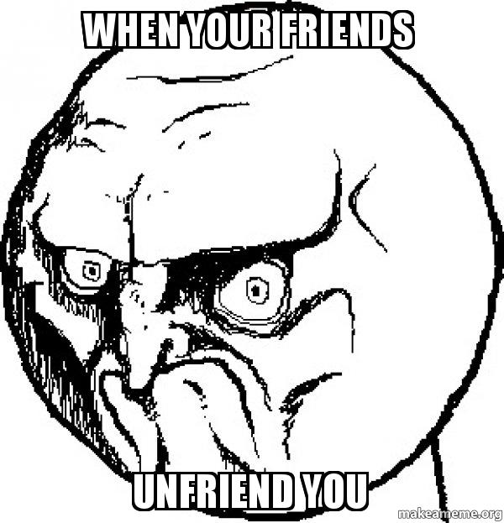
Tips and Hints
If you make mistakes, take it easy: you have more knowledge than they do
NEVER lie.
ALWAYS
Smile =)
Avoid unfriendly
faces
Laugh and make jokes. Humor is a very
powerful weapon

Slide 32
elevator speech/pitch
prepare a little speech 30 seconds and then
talk without stopping!
Who am I? (introduce yourself)
What business am I in? -- What field of study am I in?
What position am I in?
What is my good skill?
What makes me different from the competition?
Similarly, in a job-hunting situation, the listener's tacit question may be "Why should I (or any employer) hire you?“

Slide 33
elevator speech/pitch example
Hi, my name is Hamza. I am currently a Political Science student attending DBKM University in Ain Defla, Algeria. In college I plan on majoring in HR. This summer I did an internship with CPA Bank. I have always had an interest in numbers and I feel certain that this is something I want to do in my future career. Next summer I’m hoping to get another internship learning more about how the international finanicial market operates. I read that your organization looking for Finance manager. Can you tell me how someone with my experience may fit into your organization?

Slide 34
HOW TO WRITE AN ABSTRACT

Slide 35
IN THIS LESSON
WHAT IS AN ABSTRACT
FOR WHAT PURPOSES
DIFFERENT TYPES OF ABSTRACT
WHAT TO INCLUDE
WHAT NOT TO INCLUDE
SOME EXAMPLES

Slide 36
WHAT IS AN ABSTRACT?
A short, self-contained, powerful summary of an article, paper or thesis;
Length: between 150 and 250 words;
Layout: usually one single paragraph; font size is different from the main text;
Position: usually at the beginning of the paper

Slide 37
FOR WHAT PURPOSES?
TO PERSUADE THE READER TO SEE THE FULL TEXT
TO HELP READERS DECIDE IF THE ARTICLE IS RELEVANT FOR THEIR PURPOSES
TO ANSWER A CALL OF PAPER IN A CONFERENCE

Slide 38
DIFFERENT TYPES OF ABSTRACT
Abstracts are usually divided into two main categories:
DESCRIPTIVE AND INFORMATIVE
1/ Descriptive abstracts describe:
What the text is about
The issues or problems explored
The purpose and methodology of the research

Slide 39
DIFFERENT TYPES OF ABSTRACT (continued)
2/Informative abstracts describe:
What the text is about
The issues or problems explored
The purpose and methodology of the research
The results
The conclusion and recommendations

Slide 40
Writing Style
Clarity وضوح
Concision الإيجاز
Accuracy دقة

Slide 41
WHAT TO INCLUDE
Reason for writing: What is the importance of the research? Why would a reader be interested in the larger work?
Problem: What problem does this work attempt to solve? What is the scope of the project? What is the main argument/thesis/claim?

Slide 42
WHAT TO INCLUDE (continued)
Methodology: An abstract may include specific models or approaches used in the larger study.
Results: Again, an abstract may include specific data that indicates the results of the project. Other abstracts may discuss the findings in a more general way.

Slide 43
WHAT NOT TO INCLUDE
Information not contained in the original work;
References to other work;
Quotations from the original work or from other works;
Lengthy explanations of words and concepts;
Unexplained acronyms or abbreviations;
Tables and maps.

Slide 44
Abstract Language
Introduction (usually in present, could also be in present perfect or simple past tense):
The purpose of this study is to investigate the effects of ... on ...
The goals of this study are to determine …
The primary purpose of this study is to determine …
This study is specifically concerned with the effect of … on …
This study is an initial attempt to investigate the relationship …
This study has two major purposes: (1) to investigate ... (2) to demonstrate …
This thesis discusses/describes/analyses/studies/focuses on/deals with …

Slide 45
Abstract Language
Materials and Methods (in past tense):
The subjects of this study were …
This study was conducted in Khemis Miliana/ at Emir Abdel Kader High School.
Data for this study/research were collected/gathered/obtained from/by/through/with the help of/among …
A questionnaire was distributed/mailed/sent to …
Interviews were conducted by/with …
The interviews were recorded on audiotape.
Using local and national data, this study was designed to investigate.
The empirical part of this study was conducted in May 2017.

Slide 46
Abstract Language
Conclusions (in simple present or past tense):
These results suggest that …
The results show that/reveal …
It was concluded that …
This study/survey shows/supports/questions/implies/indicates …
On the basis of the results of this research, it can be concluded that …
The results provide some support for …(ing)…
The results did not support the expectations that …
These data support the view that …

Slide 47
Sample abstracts for paper
Abstract : The study is to show how the French occupation in Algeria exercised all kinds of crimes such as: genocide, murder, and torture against the Algerian defenseless people, even in the eve of its independence the occupation committed the most heinous crimes on Algerian territory since 1832, The Reggan’s nuclear test on February 13th1960, This case example shows how French occupation surpassed the rules of the international law and ignored the Geneva conventions.
The key words: The French occupation – The Reggan’s nuclear test – Humanitarian Law

Slide 48
Further vocabulary
1. Verbs: show, demonstrate, illustrate, prove, argue, examine, explore, look into, consider, deal with, address, involve, relate to, refer to, draw on, explain, investigate, highlight, outline, provide an overview of, define, distinguish between, indicate, support, reveal, suggest, conclude, recommend
2. Nouns: intention, purpose, aim, objective, thesis, argument, issue, assumptions, methods, premises, results, conclusions, outcome, recommendations
3. Connecting words: however, first, second, then, finally, thus, for example, furthermore, in addition, in conclusion, by contrast, nonetheless, consequently, etc.

Slide 49
Sample abstracts for thesis
The aim of this thesis is to investigate and identify the present status of abstract writing in English for bachelor’s and master’s theses at the DBKM, and to make recommendations for students who are required to produce abstracts in English.
In the first part, results of a short empirical survey of the university faculties and degree programs are presented. These show that there is growing demand for student abstracts in English, but at present students receive very little guidance in this matter.
The thesis then identifies the uses of an English abstract, and further outlines the structure of an abstract. In a detailed central section the thesis provides students with useful practical tips on the language of abstracts, including rules for creating headings and titles, and giving lists of phrases and vocabulary that are commonly used in abstracts. Here, the thesis draws on a number of sources from other universities and books on academic writing in English.
In conclusion, the thesis argues that abstract writing in English is essential but that students should not be expected to be able to write good abstracts without assistance. This thesis hopes to offer all DBKM students useful tips on writing abstracts in English, and thus make a small contribution to improving the general standard of bachelor’s and master’s theses.

Slide 50
Quote of the Day

