Slide 1
University of Khemis Miliana Faculty of Law & Political Science Department of Political Science PUBLIC SPEAKING TRAINING BY MESTEK YAHIA MOHAMED LAMINE
m.mestek-yahia@univ-dbkm.dz
@laminemestek
lamine.mestek
Lamine.mestek

Slide 2
My Youtube Channel

Slide 3
My Facebook Page

Slide 4
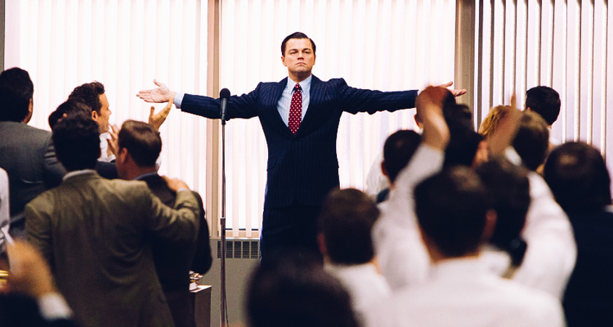
Public Speaking: Tips & Techniques

Slide 6
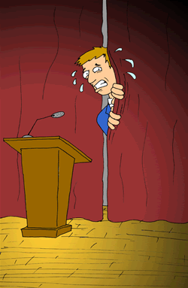
Public Speaking: Tips & Techniques
“According to most studies, people's number one fear is public speaking. Number two is death. Death is number two. Does that sound right?

Slide 7
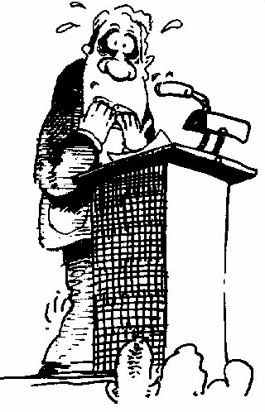
Why Do We Hate Public Speaking?
Lack of Positive Experience
Being the Center of Attention
Feelings of Isolation
Being Judged by an Audience
Fear of Failure
All of which are part of:
Public Speaking Anxiety

Slide 8
Body Language
Content
Visual Contact
What really matters?
AudioVisual Support
Tone
Stage Fright Control

Slide 9
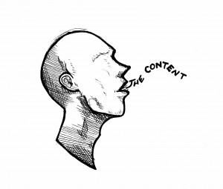
How Can I Become a Better Speaker?
Prepare the right way. Start by answering these questions:
What is the specific purpose of your speech?
What is your topic?
Who is your audience?
What are your time constraints?
Will you be using visual aids?

Slide 10
Pre-Performance Tips
Common qualities in speakers:
- Nervousness (shaking, turning red)
- Anxiety (healthy amount is OK)
- Looking down/back of room
- Staying stationary/moving too much
- Speaking at varying volumes

Slide 11
People remember:
7%
WHAT you say
93%
HOW you say
7% verbal communication
38% paralinguistic communication
55% non verbal communication

Slide 12
Pre-Performance Tips
The Visual Channel – competence, trustworthiness, and character.
7% words, 38% voice, 55% nonverbal communication
What can you control?
- Dress
- Eye Contact
- Body language
- Vocal Variety

Slide 13
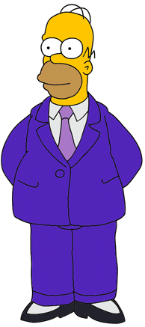
Pre-Performance Tips
Dress code
- First impressions matter – you are judged positively or negatively by your audience immediately.
- Dress in clothes that make you feel comfortable and confident.

Slide 14
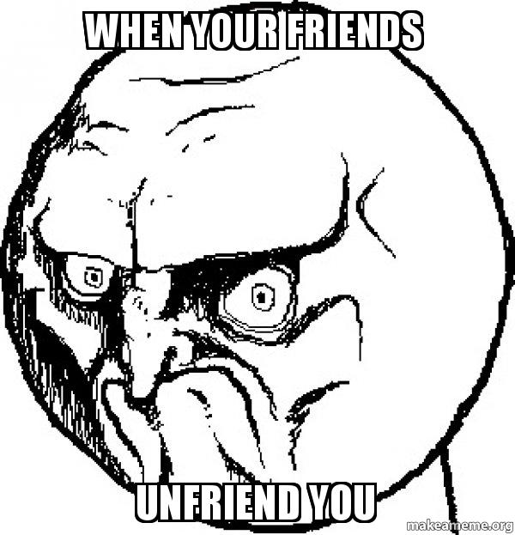
Tips and Hints
If you make mistakes, take it easy: you have more knowledge than they do
NEVER lie.
ALWAYS
Smile =)
Avoid unfriendly
faces
Laugh and make jokes. Humor is a very
powerful weapon

Slide 15
VIDEO ON HOW TO DO A GOOD PUBLIC SPEAKING

Slide 16
Tips and Hints
Opening Speech:
Greetings : you need to greet your audience by wish them good morning/afternoon or evening
Give compliment and show gratitude towards your audience For example: It’s great to see you all, Thank you for coming here today.
Start by Introducing yourself to the audience start from telling your name. Then introduce yourself professionally and give quite information about what you do and why are here today. For Example: I am a Master Student in Political Science at DBKM University. And today I am here to provide you some exciting information about ………….., which is going to be very beneficial for you in future.

Slide 17
Tips and Hints
“Good afternoon every one, it’s great to see you all here, thank you for coming. My name is Hamza Slimani. I am a Master Student in Political Science at DBKM University. Today we are here to know about Climate Change so that we can take most of it. Firstly, we will look at…………., next we will discuss ………………….., then we will learn ………………………..and finally we will discuss ………………………..”

Slide 18
Tips and Hints
Closing Remarks For Presentations:
Formal Closing Remarks:
“It’s been a pleasure being with all of you today, thank you”
“Thank you all for your patience, I wish you all a very good evening. Good Bye”
“It’s been an honor to be among such accomplished individuals and to be able to present my perspective before you all, thank you and good evening/day”
“Thank you all for being here today and taking the time to patiently listen to what I had to say, I wish you all a blessed day”

Slide 19
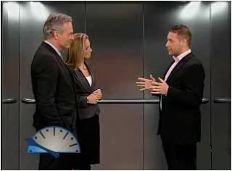
elevator speech/pitch
prepare a little speech 30 seconds and then
talk without stopping!
Who am I? (introduce yourself)
What business am I in? -- What field of study am I in?
What position am I in?
What is my good skill?
What makes me different from the competition?
Similarly, in a job-hunting situation, the listener's tacit question may be "Why should I (or any employer) hire you?“

Slide 20
elevator speech/pitch example
Hi, my name is Hamza. I am currently a Political Science student attending DBKM University in Ain Defla, Algeria. In college I plan on majoring in HR. This summer I did an internship with CPA Bank. I have always had an interest in numbers and I feel certain that this is something I want to do in my future career. Next summer I’m hoping to get another internship learning more about how the international finanicial market operates. I read that your organization looking for Finance manager. Can you tell me how someone with my experience may fit into your organization?

